Slide 1
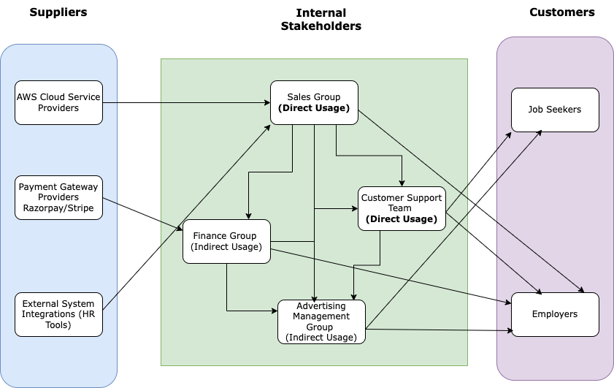
HireHub-Job Application System: Business Relationship Map

Slide 2
HireHub-Job Application System: SIPOC Diagram
S
I
P
O
C
Supplier
Inputs
Process
Outputs
Customers
Development and Maintenance
Subscription and Account Management
Customer Support
Advertising Management
Financial operations
Cloud Service
Providers (AWS)
Payment Gateway
Providers
External
Integrations
(HR Tools)
Cloud services
Payment
Information
HR Management
Data
Customer
Feedback
Platform Features
Revenue Streams
Customer Support Solutions
Advertising Campaigns
Job
Seekers
Employers

Slide 3
User Roles by Business Group
External Users (Customers)
Job Seekers (Rohith)
Employers (Raj)
Internal Users
Team Members gather business requirements for their assigned business stakeholders.
Business Group | User Roles | Team Member Name (Bus. Group Proxy)
Sales Group | Business Development Manager Sales Executive Client Relationship Manager | Annette Abhi Neha
Finance Group | Financial Analyst Business Analyst | Manu Rob
Customer Support Team | Customer Support Specialist | John
Advertising Management Group | Marketing Analyst Product Analyst | Andy Rebecca

